Slide 1
CS542 Project
Link State Routing Protocol
Bhargavi Deshpande
A20395720

Slide 2
Outline
Introduction
Link State Routing Protocol
Dijkstra's Algorithm
Screenshots

Slide 3
Introduction
The network layer is considered the backbone of the OSI Model. It selects and manages the best logical path for data transfer between nodes.
This layer contains hardware devices such as routers, bridges, firewalls and switches, but it actually creates a logical image of the most efficient communication route and implements it with a physical medium.
Network layer protocols exist in every host or route
Network Layer is used to move packets from a sending host to a receiving host.
Two important network layer functions are identified
Forwarding- When a packet arrives at a router’s input link, the router must move the packet to the appropriate output link.
Routing- The network layer must determine the route or path taken by packets as they flow from a sender to a receiver .The Algorithms that calculate these paths are referred to as routing algorithms.

Slide 4
Introduction ….
Packets are moved from source to destination via routers.
Every router has a forwarding table.
A router forwards a packet by examining the value of a field in the arriving packet’s header, and then using this header value to index into the router’s forwarding table.
The value stored in the forwarding table entry for that header indicates the router’s outgoing link interface to which that packet is to be forwarded.
Router chooses the path which is optimal.
In real time applications the shortest time is taken into consideration for optimal path.

Slide 5
Link State Routing Protocol
It is a interior gateway routing protocol.
The link-state protocol is performed by every switching node in the network
Examples include
OSPF(Open shortest path first)
Intermediate system to Intermediate system

Slide 6
Link State Routing Protocol …
The basic concept of link state routing is that every node constructs a map of the connectivity to the network in the form of graph ,showing which nodes are connected to which other nodes.
Each node then independently calculates the next best logical path from it to every possible destination in the network .
Each collection of best paths will then form each node’s routing table.
In a link-state protocol the only information passed between nodes is connectivity related

Slide 7
Link state Routing Protocol…
Link-state algorithm produces routing tables, by inspecting the maps.
Each node independently runs an algorithm over the map to determine the shortest path from itself to every other node in the network. The algorithm used is Dijkstra’s Algorithm.
With the shortest paths in hand routing table is filled.
For any given destination node the best path for that destination is the node which is the first step from the root node down the branch in the shortest-path tree which leads toward the desired destination node.

Slide 8
Dijkstra’s Algorithm
Fastest known Single Source Shortest Path Algorithm
Accept Matrix, Source, Destination
Calculate shortest paths
Determine cost for the path from source to destination
Return the Cost and the Path

Slide 9
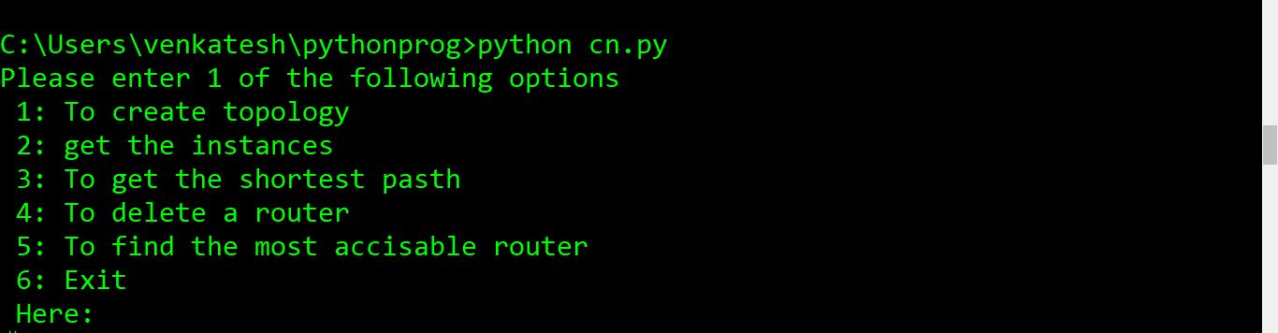
Screenshots

Slide 10
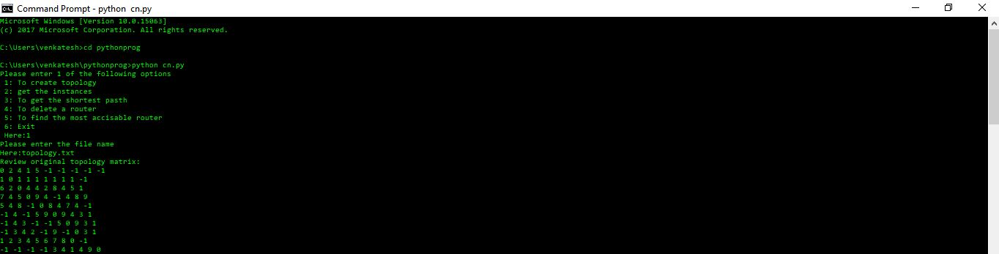

Slide 11
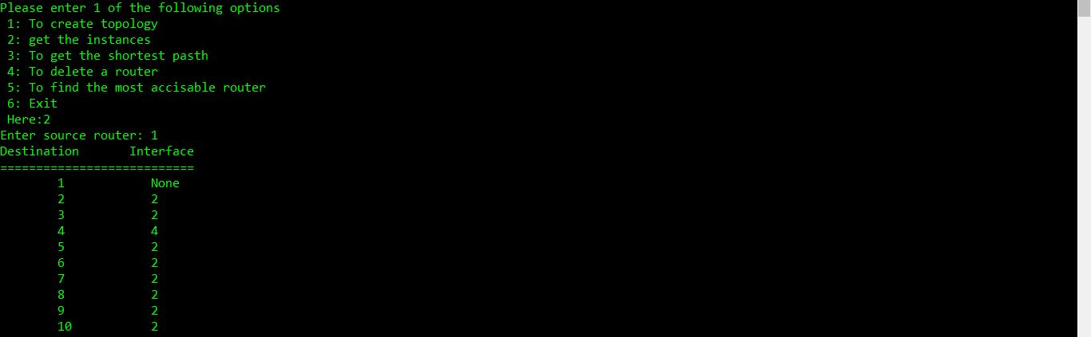

Slide 12
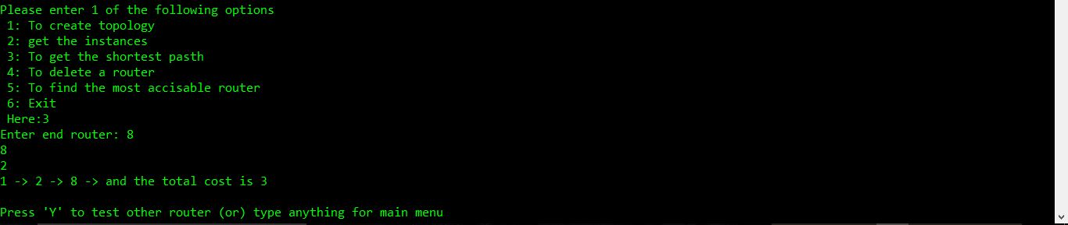

Slide 13
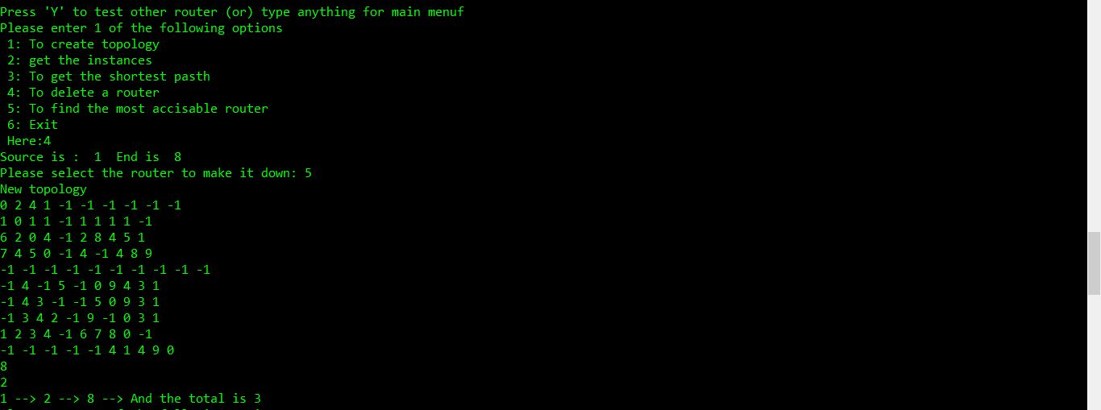

Slide 14
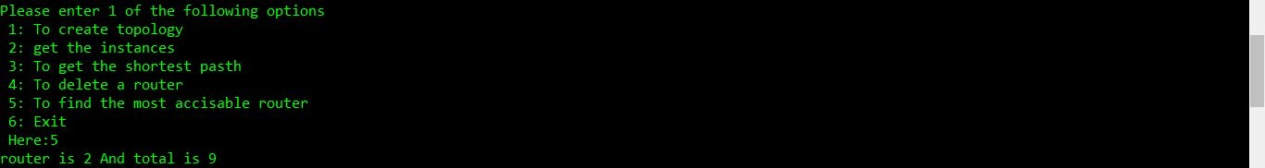

Slide 15
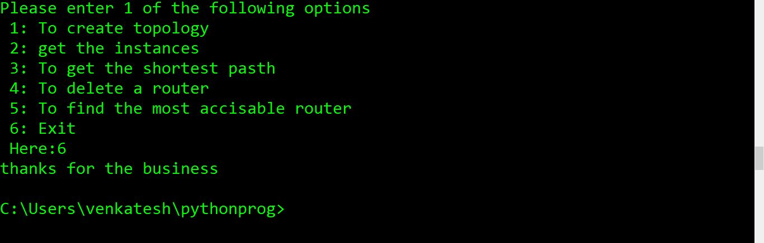

Slide 16
References
https://www.techopedia.com/definition/24204/network-layer
https://electronicspost.com/forwarding-and-routing-in-network-layer/
https://en.wikipedia.org/wiki/Link-state_routing_protocol
https://en.wikipedia.org/wiki/Dijkstra%27s_algorithm
http://www.gitta.info/Accessibiliti/en/html/Dijkstra_learningObject1.html

Slide 17
Limitations and Further Research :
Range of aspects: Defining a small number of face classes for each known person corresponding to characteristic views.
When an image is close to face but is not classified as one of the familiar faces then it is labeled as “unknown”
If a collection of “unknown” pattern vectors cluster in the pattern space, the presence of a new but unidentified face is postulated.
Optimizing speed in images analyzing
Noise or occlusion cause performance degradation

Slide 18
Conclusion-Eigenfaces
Although not an elegant solution to the general object recognition problem but the eigen face approach do provide a practical solution.
It is fast and relatively simple.
Works well in constrained environment.

